Slide 1
ZB4171 A generative model for spatial omics
Ernest Oh
Joseph Lee

Slide 2
Overview
Background
Motivation
Objective
Approach
Timeline

Slide 3
Overview
Background
Motivation
Objective
Approach
Timeline

Slide 4
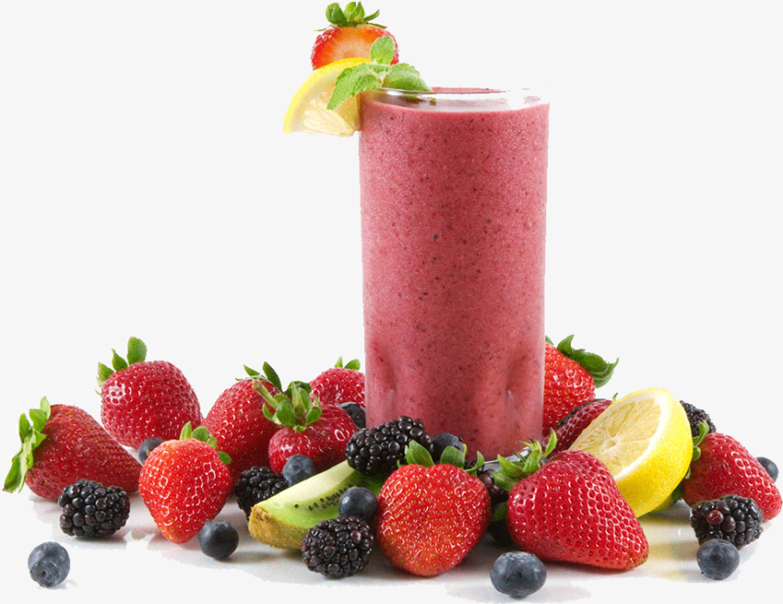
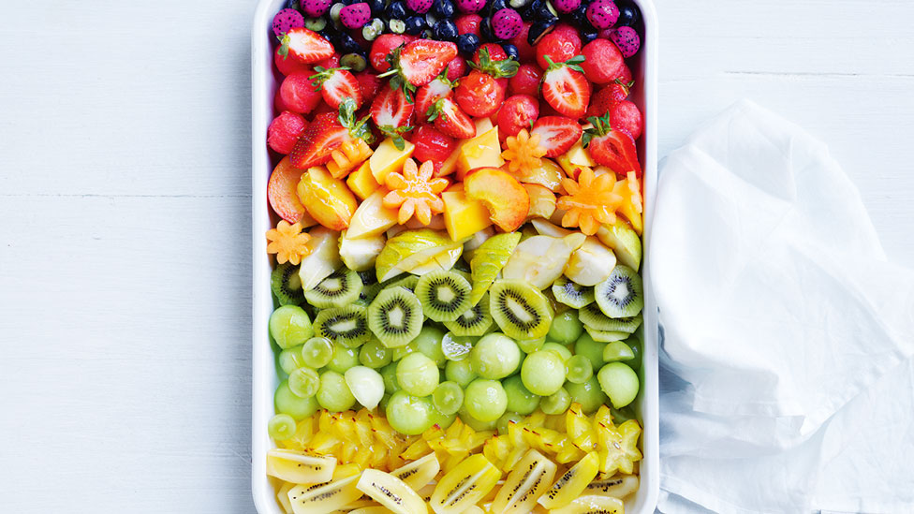
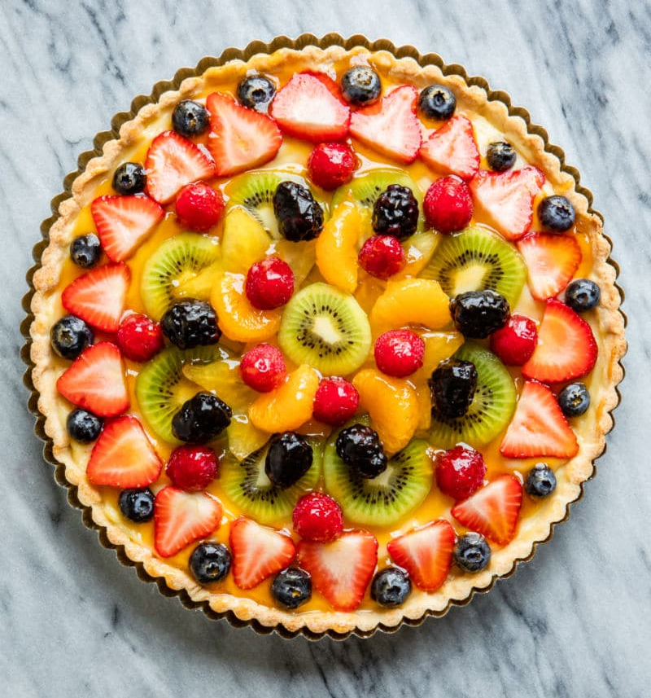
Profiling expression
Bulk sequencing
Single-cell sequencing
Spatial omics

Slide 5
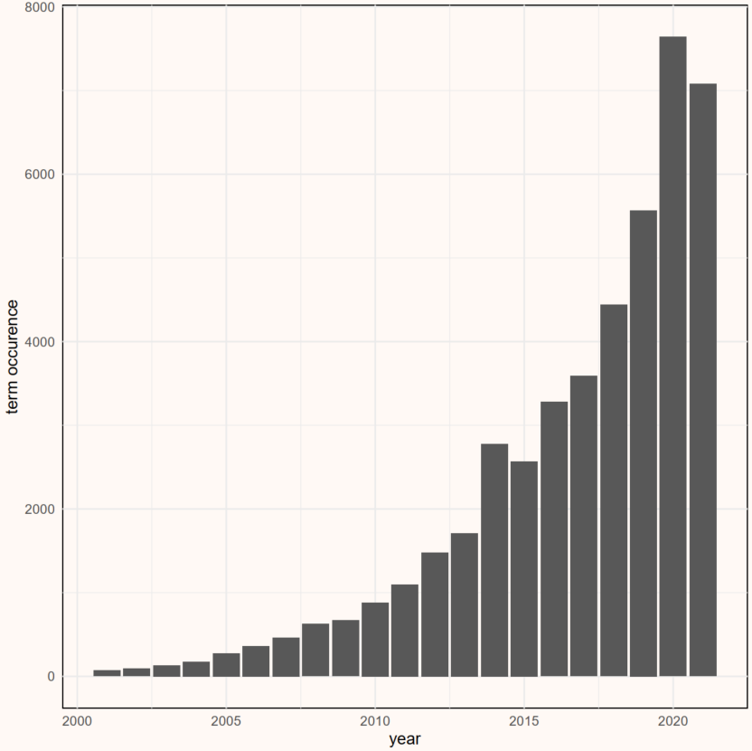

Spatially-resolved omics
Measuring gene activity in a tissue, and mapping where it occurs:
Molecular + Spatial profiling

Slide 6
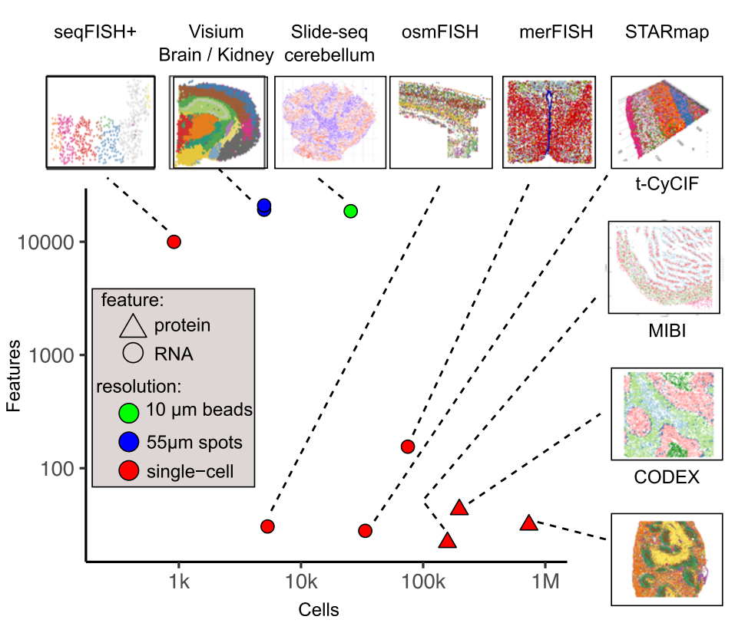
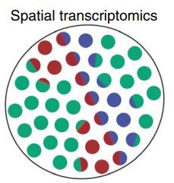
Imaging resolution and coverage
Ideal
Dries, R., Zhu, Q., Dong, R. et al. Giotto: a toolbox for integrative analysis and visualization of spatial expression data. Genome Biol 22, 78 (2021).

Slide 7
Overview
Background
Motivation
Objective
Approach
Timeline

Slide 8


Motivation
Increasing amounts of spatial omics data being generated
Biological insight into cell-type and spatial heterogeneity

Slide 9
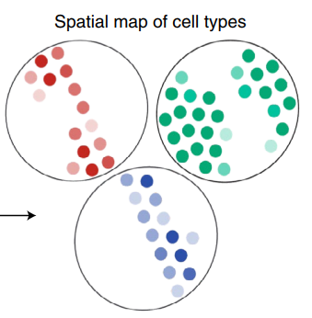
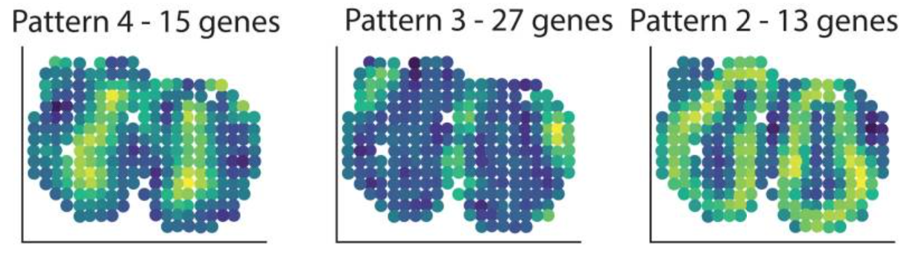
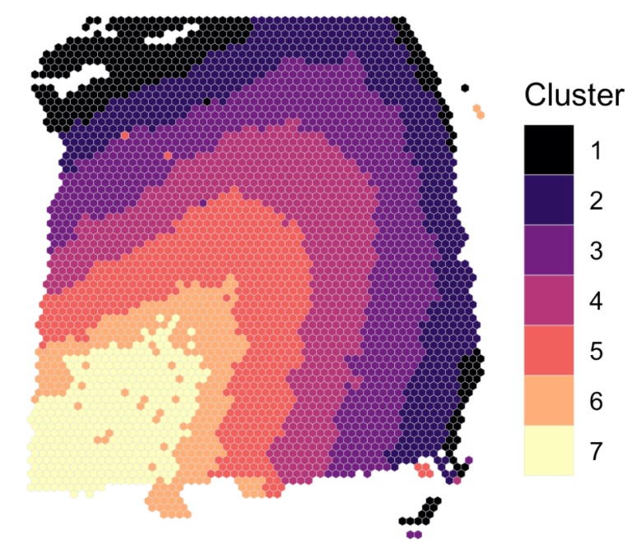
Motivation
While methods exist for
Spot deconvolution (e.g. Robust Cell Type Deconvolution)
Identification of spatial patterns (e.g. SpatialDE)
Spatial clustering (e.g. BayesSpace)
Integration of spatial information with expression remains challenging

Slide 10
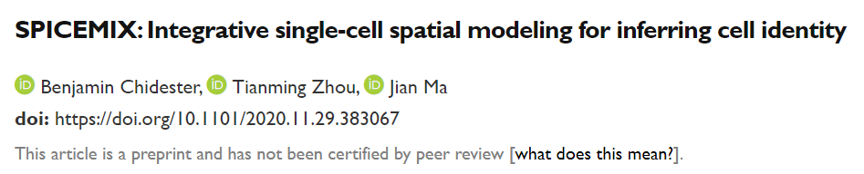
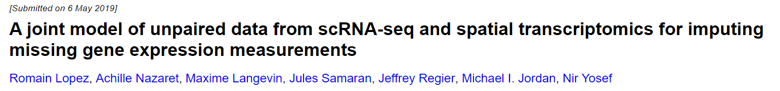
Related work
Joint modelling of expression and spatial data
Matrix Factorization + Hidden Markov Random Fields
Deep neural netwokrs

Slide 11
Overview
Background
Motivation
Objective
Approach
Timeline

Slide 12
Objective
Given gene expression counts and spatial location of each cell, develop a generative model that jointly models these features, for
Clustering
Identification of spatially variable genes
Develop R / Python scripts to run the model

Slide 13
Overview
Background
Motivation
Objective
Approach
Timeline

Slide 14
Data
merFISH data of mouse hypothalamic preoptic region
~1.1 million cells across 30 mice
3 spatial dimensions
125 genes
Moffitt, J. R., Bambah-Mukku, D., Eichhorn, S. W., Vaughn, E., Shekar, K., Perez, J. D., Rubinstein, N. D., Hao, J., Regev, A., Dulac, C., & Zhuang, X. Molecular, spatial, and functional single-cell profiling of the hypothalamic preoptic region. Science 362, (2018)

Slide 15
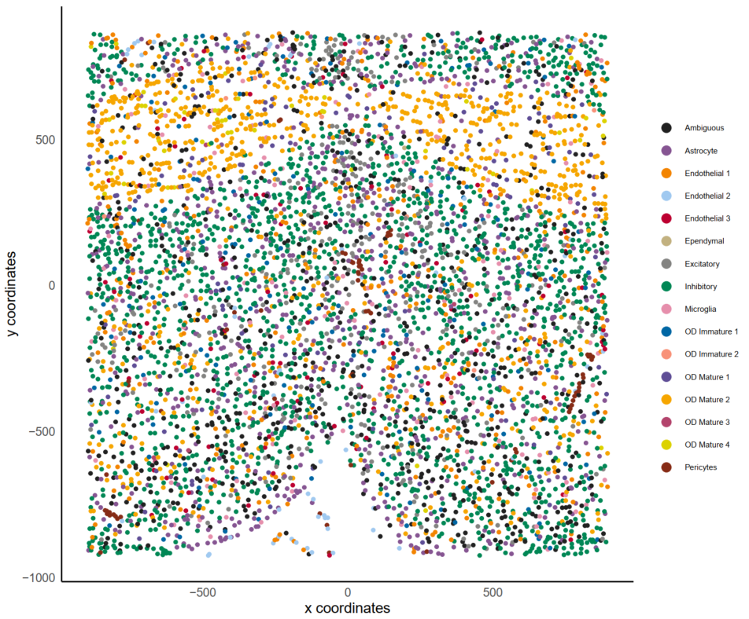
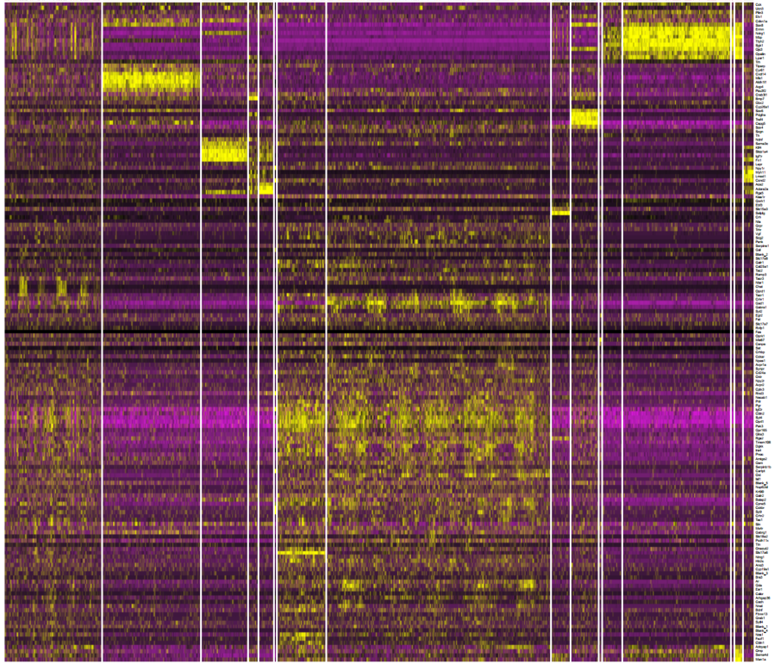
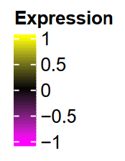
Data

Slide 16
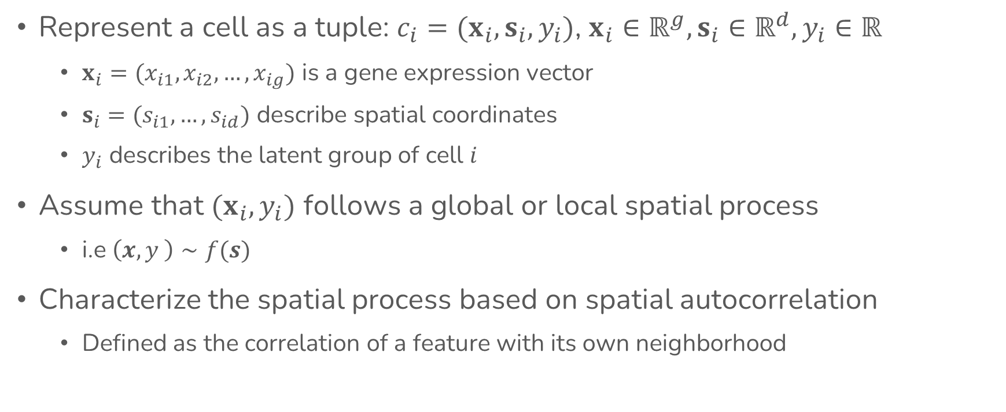
Model
Represent a cell as a tuple: $c_{i}=(x_{i}, s_{i}, y_{i})$, $x_{i}∈ℝ^{g},s_{i}∈ℝ^{d},y_{i}∈ℝ$
$x_{i}=(x_{i1},x_{i2},…,x_{ig})$ is a gene expression vector
$s_{i}=(s_{i1},…,s_{id})$ describe spatial coordinates
$y_{i}$ describes the latent group of cell $i$
Assume that $(x_{i},y_{i})$ follows a global or local spatial process
i.e $\left(x,y \right)∼f(s)$
Characterize the spatial process based on spatial autocorrelation
Defined as the correlation of a feature with its own neighborhood

Slide 17
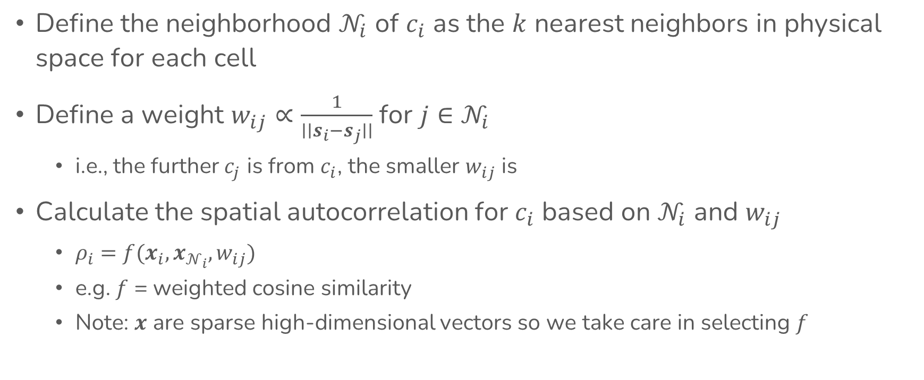
Model
Define the neighborhood $𝒩_{i}$ of $c_{i}$ as the $k$ nearest neighbors in physical space for each cell
Define a weight $w_{ij}∝\frac{1}{∣∣s_{i}−s_{j}∣∣}$ for $j∈𝒩_{i}$
i.e., the further $c_{j}$ is from $c_{i}$, the smaller $w_{ij}$ is
Calculate the spatial autocorrelation for $c_{i}$ based on $𝒩_{i}$ and $w_{ij}$
$ρ_{i}=f(x_{i},x_{𝒩_{i}},w_{ij})$
e.g. $f$ = weighted cosine similarity
Note: $x$ are sparse high-dimensional vectors so we take care in selecting $f$

Slide 18
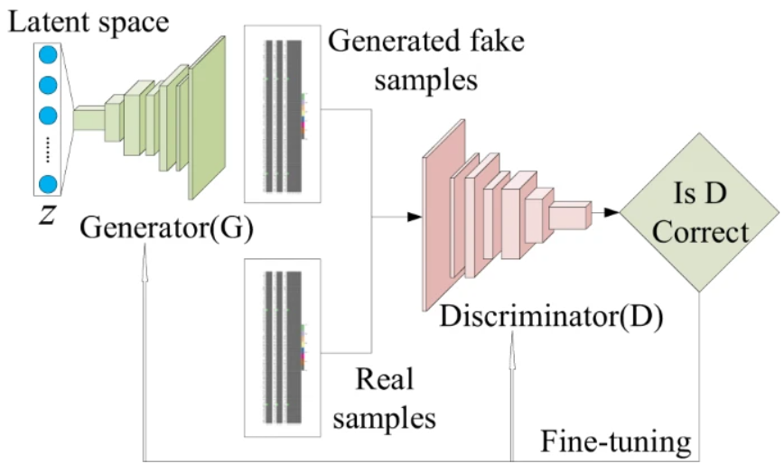
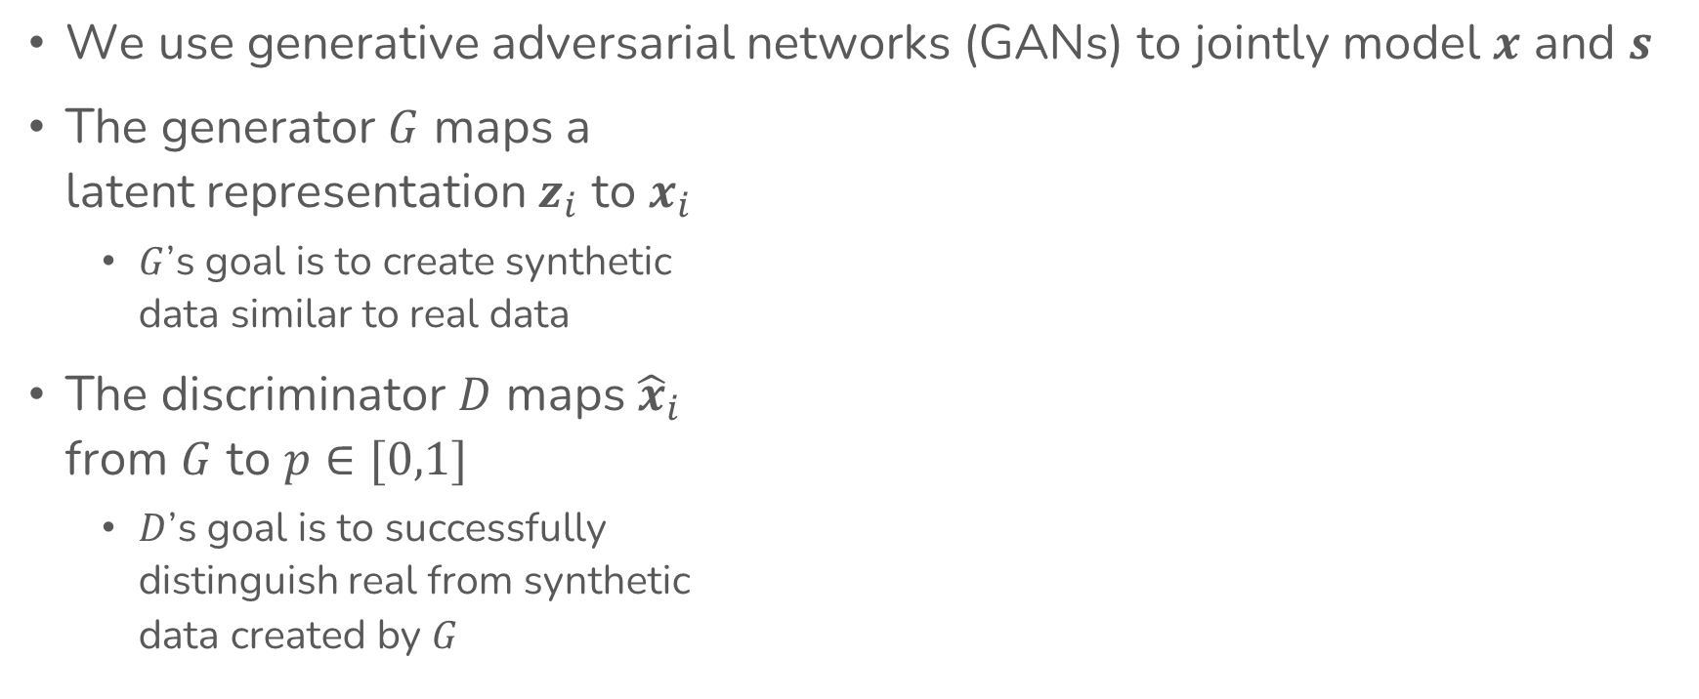
Model
We use generative adversarial networks (GANs) to jointly model $x$ and $s$
The generator $G$ maps a latent representation $z_{i}$ to $x_{i}$
$G$’s goal is to create synthetic data similar to real data
The discriminator $D$ maps ${\hat{x}}_{i}$ from $G$ to $p∈[0,1]$
$D$’s goal is to successfully distinguish real from synthetic data created by $G$

Slide 19
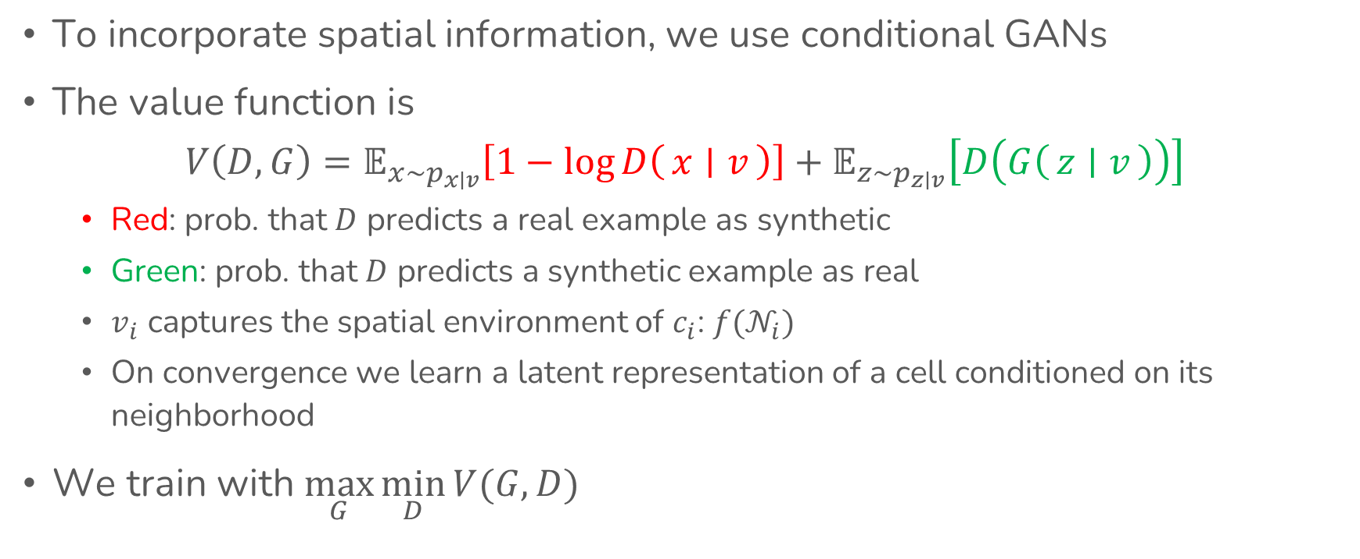
Model
To incorporate spatial information, we use conditional GANs
The value function is $V\left(D,G\right)=𝔼_{x∼p_{x∣v}}\left[1−log{D\left(x ∣ v\right)}\right]+𝔼_{z∼p_{z∣v}}\left[D\left(G\left(z ∣ v\right)\right)\right]$
Red: prob. that $D$ predicts a real example as synthetic
Green: prob. that $D$ predicts a synthetic example as real
$v_{i}$ captures the spatial environment of $c_{i}$: $f(𝒩_{i})$
On convergence we learn a latent representation of a cell conditioned on its neighborhood
We train with $\max_{G}{\min_{D}{V(G,D)}}$
Klemmer, Konstantin, Koshiyama, Adriano, and Flennerhag, Sebastian. Augmenting correlation structures in spatial data using deep generative models. arXiv preprint ariXiv:1905.09796. (2019)

Slide 20
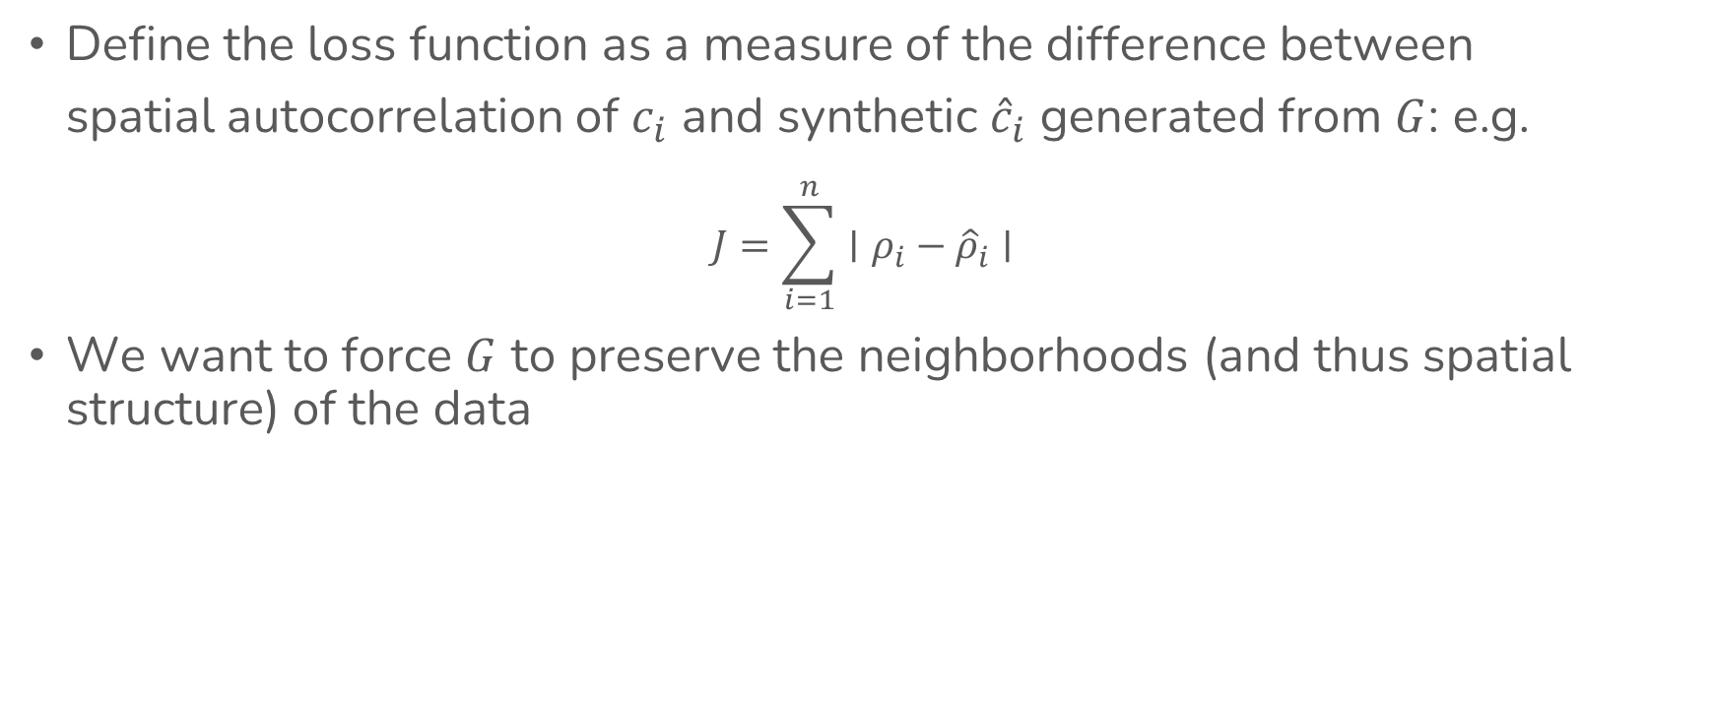
Model
Define the loss function as a measure of the difference between spatial autocorrelation of $c_{i}$ and synthetic ${\hat{c}}_{i}$ generated from $G$: e.g.
$$J=\sum_{i=1}^{n}{∣ρ_{i}−{\hat{ρ}}_{i}∣}$$
We want to force $G$ to preserve the neighborhoods (and thus spatial structure) of the data

Slide 21
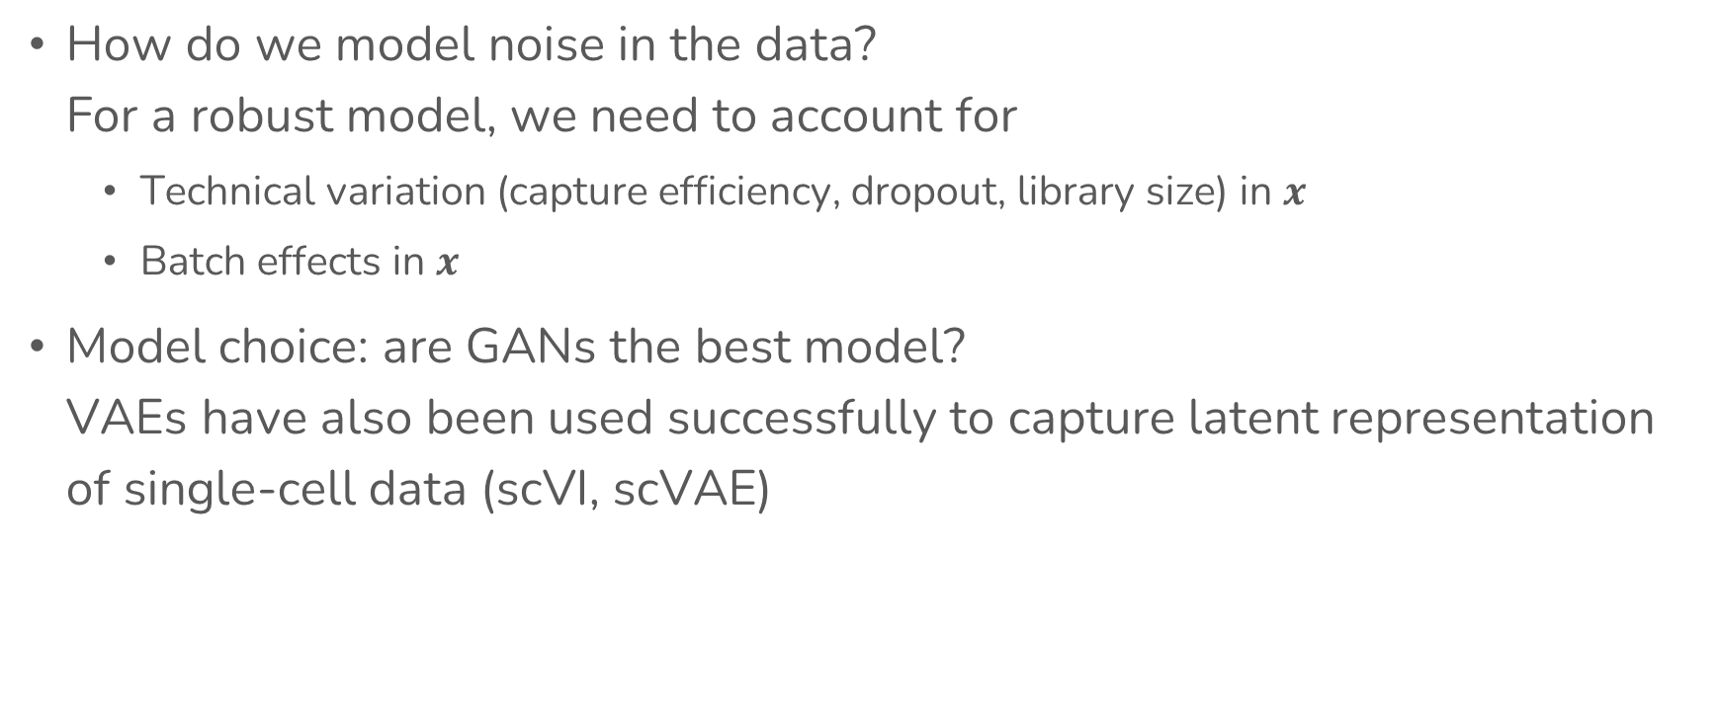
Open questions
How do we model noise in the data? For a robust model, we need to account for
Technical variation (capture efficiency, dropout, library size) in $x$
Batch effects in $x$
Model choice: are GANs the best model? VAEs have also been used successfully to capture latent representation of single-cell data (scVI, scVAE)
Klemmer, Konstantin, Koshiyama, Adriano, and Flennerhag, Sebastian. Augmenting correlation structures in spatial data using deep generative models. arXiv preprint ariXiv:1905.09796. (2019)

Slide 22
Overview
Background
Motivation
Objective
Approach
Timeline

Slide 23
Timeline
Week | Task
Week 6 - Recess | Model specification, parameterization
Week 7 - 11 | Model implementation, evaluation
Week 12 | Model robustness
Week 13 | Presentations, report and technical work

